Slide 1

Intelligent Epidemiological
Surveillance in
Brazilian Semiarid
IEEE Healthcom 2020
Notes:
Hi, thanks for join us in the IEEE Healthcom 2020. I’m Raimundo Valter and I’ll presente the article intitle Intelligent Epidemiological Surveillance in Brazilian Semiarid.

Slide 2





Team
Luiz Odorico Monteiro
LARIISA Digital Health
Coordinator, FIOCRUZ Ceará
José Neuman
Computer Science Dept., UFC
Fortaleza, Brazil
Ivana Barreto
LARIISA Digital Health
Coordinator, FIOCRUZ Ceará
Mauro Oliveira
Computer Science Dept., IFCE
Aracati, Brazil
Notes:
Our team is formed by Professors José Neuman, Mauro Oliveira, Luiz Odorico Monteiro and Ivana Barreto.

Slide 3



Team
Lucélia Saraiva Ribeiro
AvicenaTM
Fortaleza, Brazil
Daniel Andrade
AvicenaTM
Fortaleza, Brazil
Francisco G. S. da Silva
AvicenaTM
Fortaleza, Brazil
Notes:
In cooperation with Avicena team, together with Daniel Andrade, Lucélia Ribeiro and Gabriel Silva.

Slide 4




Team
Flávio Cardoso,
Data Science Dept., AvicenaTM
Fortaleza, Brazil
Raimundo Valter
Computer Science Dept., IFCE
Aracati, Brazil
Samuel Albuquerque
Ecole Polytechnique
Palaiseau, France
William Vitorino
Computer Science Dept., IFCE
Aracati, Brazil
Notes:
And the Data Science team formed by me, Flávio Cardoso, Samuel Albuquerque and William Vitorino

Slide 5
Presentation Sessions
Problem Defination
Proposed Solution
Results
Notes:
This presentation will be organized in three sessions: Problem Defination where I’ll explain some concepts about the problem itself;
Proposed solution, where I’ll presente the way we build it and Results that we got during the process.

Slide 6
Presentation Sessions
Problem Defination
Proposed Solution
Results
Notes:
Let’s go.

Slide 7
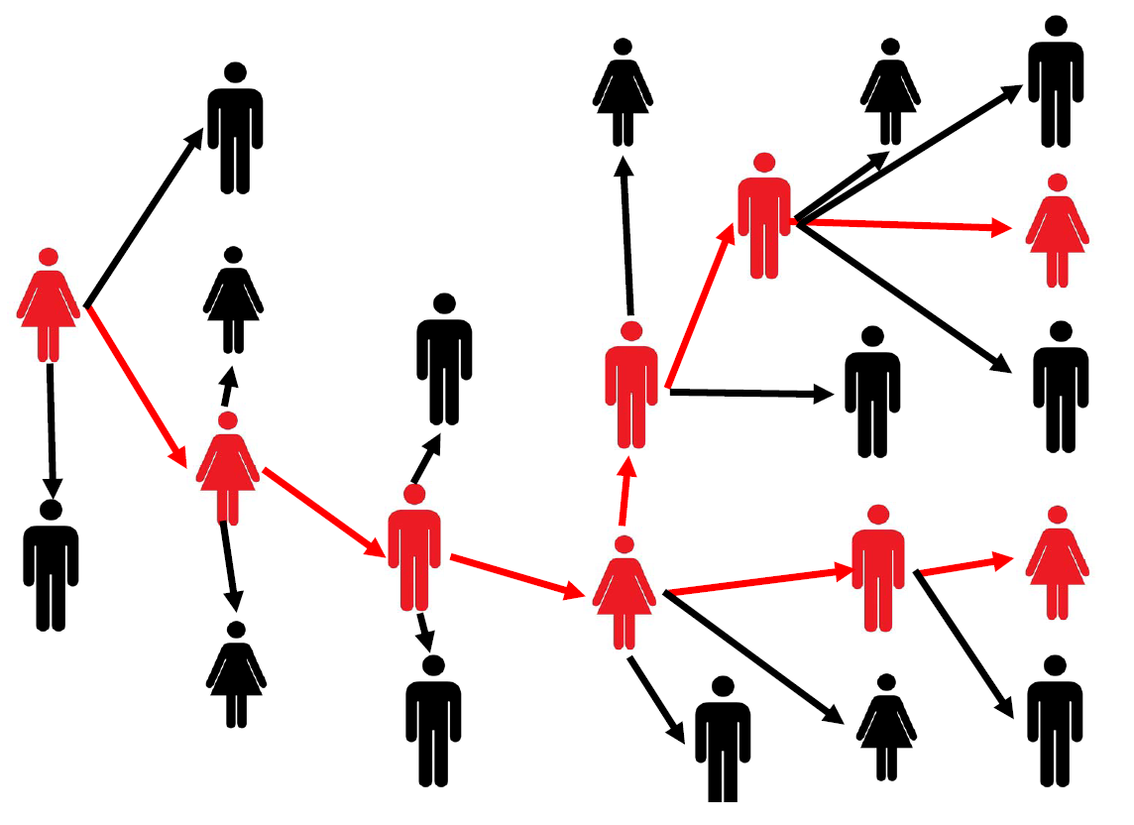
Epidemy
Notes:
Epidemics are infectious diseases that simultaneously attack a number of people in a given region. They are caused by infectious agents that are transmissible from person to person.

Slide 8


Epidemy
Caused by Arbovirus
Notes:
When the transmitting agent is an insect (arthropod) and the infectious agent is a virus, these diseases are called arboviruses. Studying these epidemics is, in large part, studying the way they spread through the mosquito.

Slide 9
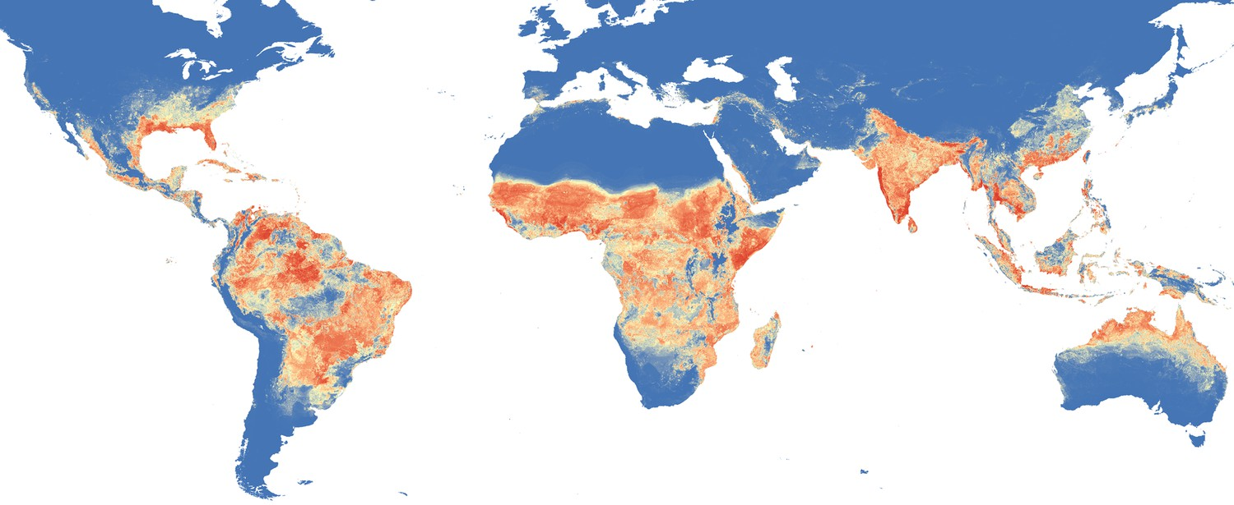
Arbovirus
Source: https://doi.org/10.7554/eLife.08347.004
Notes:
Some regions around the globe have conditions for the proliferation of mosquitoes.

Slide 10
Arbovirus
Source: https://doi.org/10.7554/eLife.08347.004
Notes:
The northeast region of Brazil is one of them.

Slide 11






32°C
22°C
Notes:
Temperatures between 25 and 35 degrees Celsius are important, but fresh standing water at that temperature is a determining condition for mosquito proliferation on a large scale.

Slide 12
Notes:
When we go in the countryside these conditions are more difficult.

Slide 13
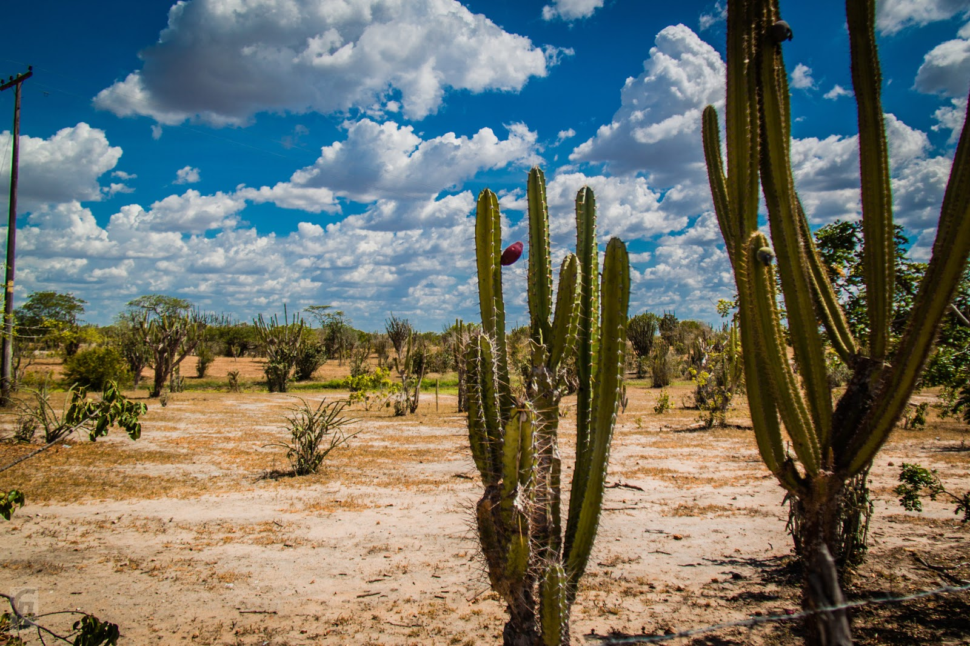
Notes:
The landscape is dry most part of the year ...

Slide 14

45°C
25°C
Notes:
High evaporation and temperatures reaching 45 degrees Celsius are reasons for a reduction in the number of arboviruses transmission cases...

Slide 15
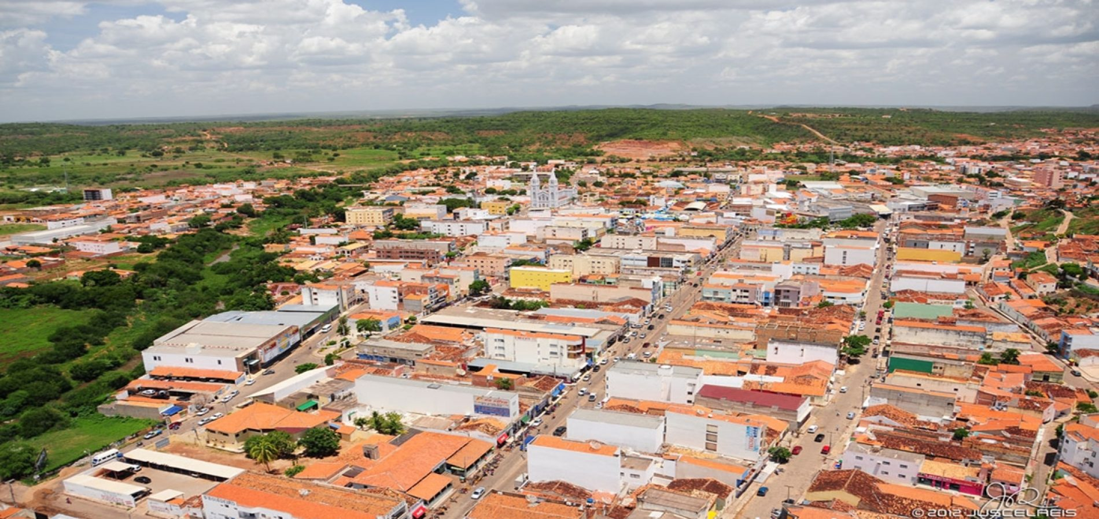
Notes:
... but when it rains. And sometimes it rains, these conditions change and ...

Slide 16
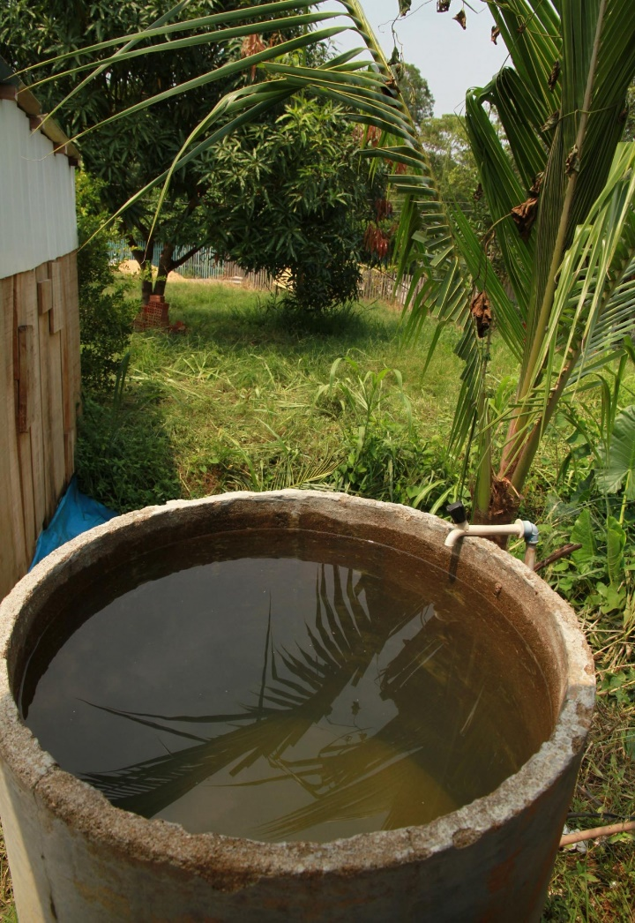
30°C
25°C
Notes:
temperatures drop and clean, still water is plentiful in cities.

Slide 17
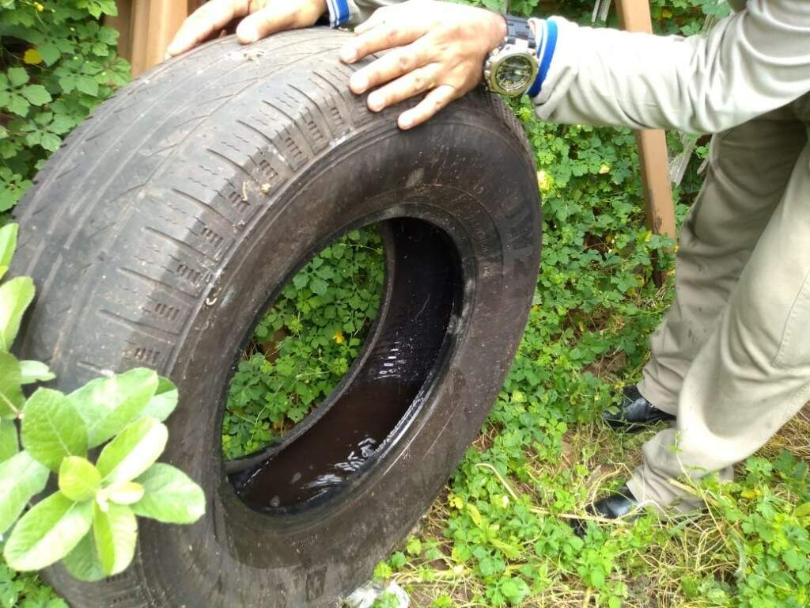
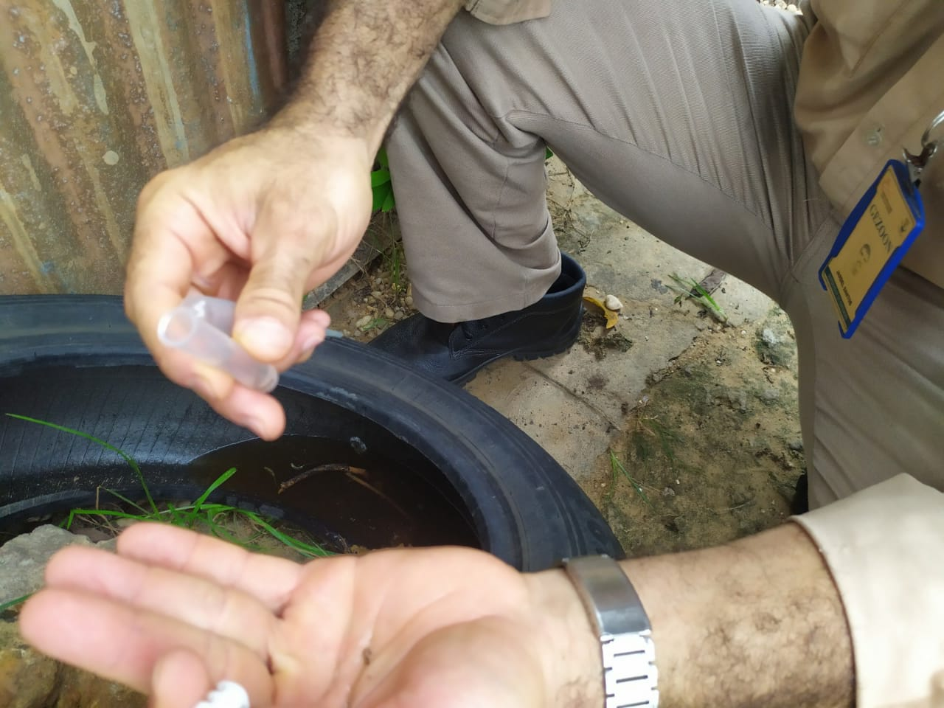
30°C
25°C
Notes:
Allowing conditions for the mosquito to breed.

Slide 18
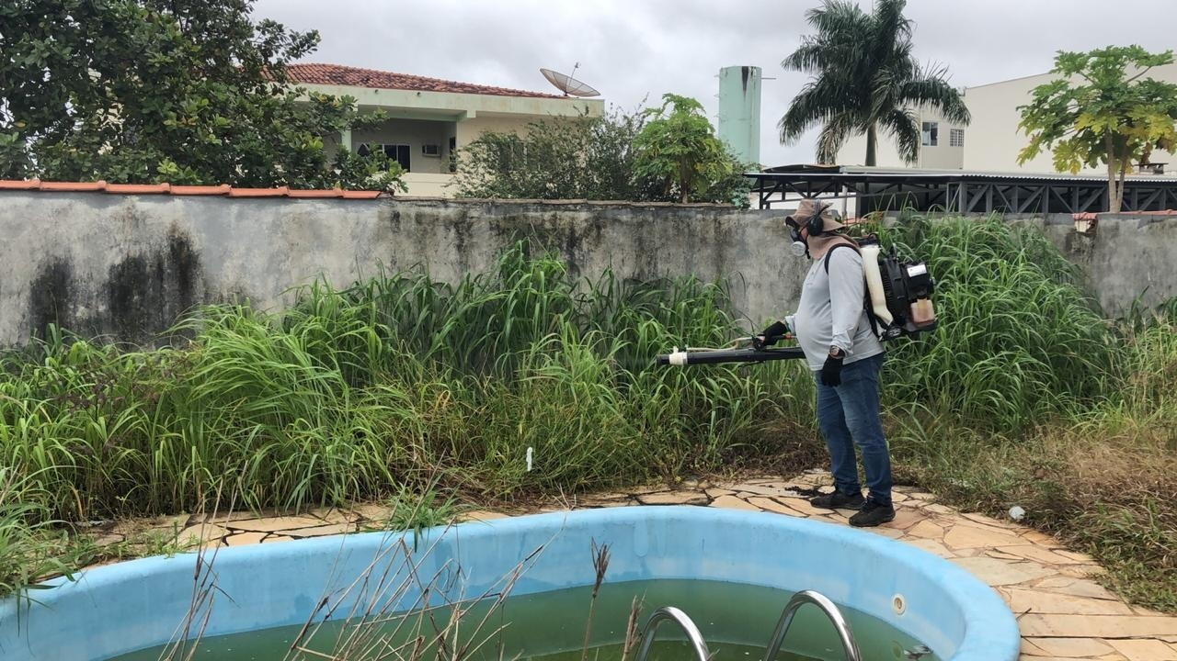

Slide 19


Notes:
Avicena is a digital health startup. One of its products is Gissa, which stands for Intelligent Governance in Health Systems.

Slide 20

Notes:
It is a web application that

Slide 21
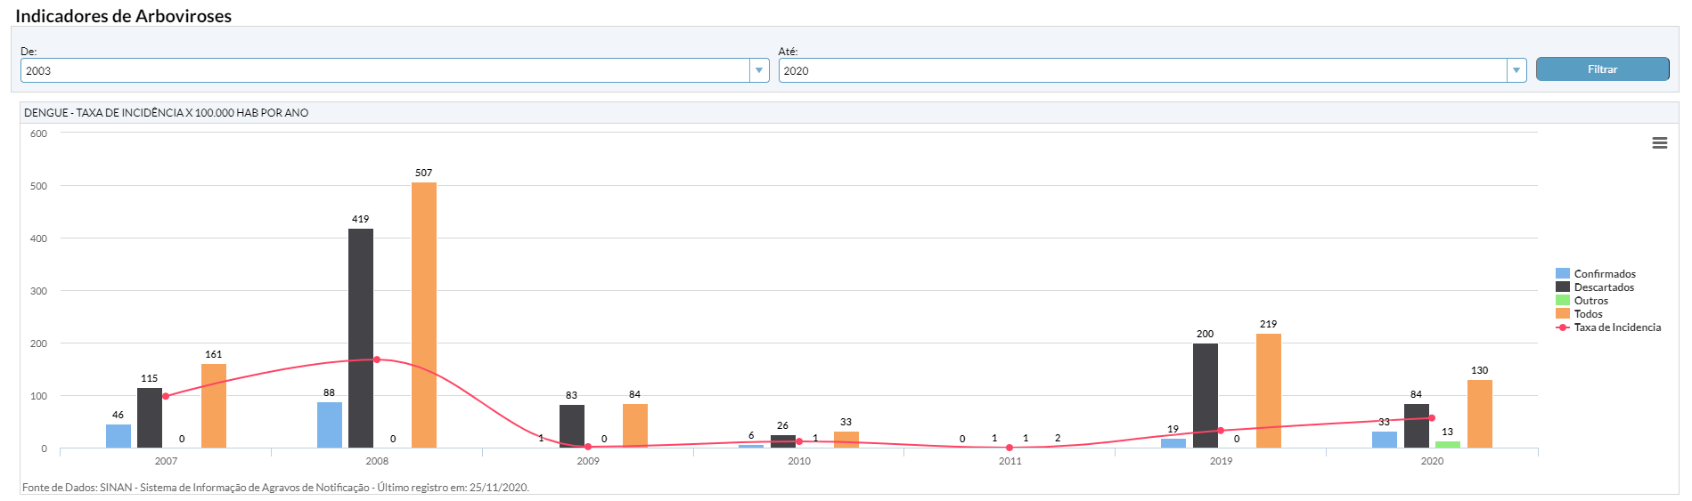
Notes:
helps governments track statistics and qualify their decisions for public health promotion.
We analyze this data and…

Slide 22

Epidemiological Surveillance
Notes:
We proposed an epidemiological surveillance system that allows the government to know in advance that there is a risk of epidemics caused by arboviruses and the amount infected that will appear in the public health system in the next few weeks. In this paper we specifically address dengue.

Slide 23
Presentation Sessions
Problem Defination
Proposed Solution
Results

Slide 24
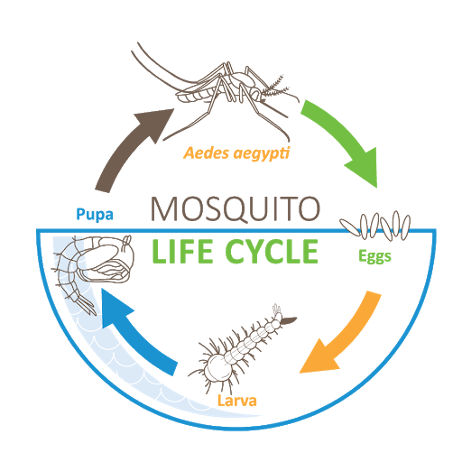
Epidemy
Caused by Aedes Aegypti
Notes:
For the mosquito to proliferate and the conditions to be met so that a major epidemic is formed, it is necessary, among other things, ...

Slide 25


Epidemy
Caused by Aedes Aegypti
Notes:
Rain, which means more standing water.

Slide 26
Epidemy
Caused by Aedes Aegypti
Notes:
Temperature at an appropriate level with little evaporation, keeping mosquito breeding sites.

Slide 27

Epidemy
Caused by Aedes Aegypti
Notes:
Low wind speeds, to facilitate mostuitoe mobility.

Slide 28


Epidemy
Caused by Aedes Aegypti
Notes:
And infected people in the region.

Slide 29
Epidemy
Caused by Aedes Aegypti
Notes:
There are government systems for meteorology and infection monitoring that provide these measurements.

Slide 30
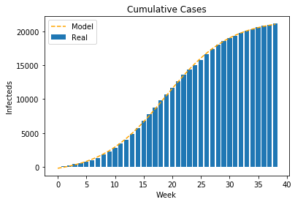
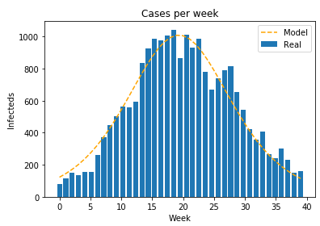
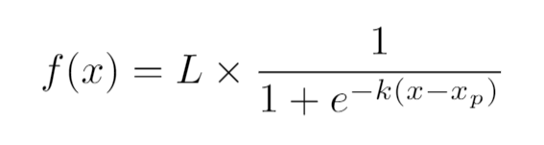
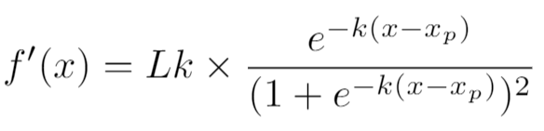
Curve Aspects
Notes:
The number of infections accumulated in an epidemic follows the logistic function and its first derivative gives us the number of new infections that occur over time.

Slide 31
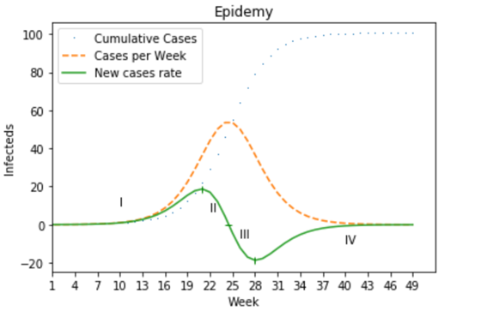
Curve Aspects
Notes:
The second derivative allows us to divide the epidemic into four stages: stage 1 and 2, beginning of the epidemic, 3 and 4, the epidemic is coming to an end.

Slide 32
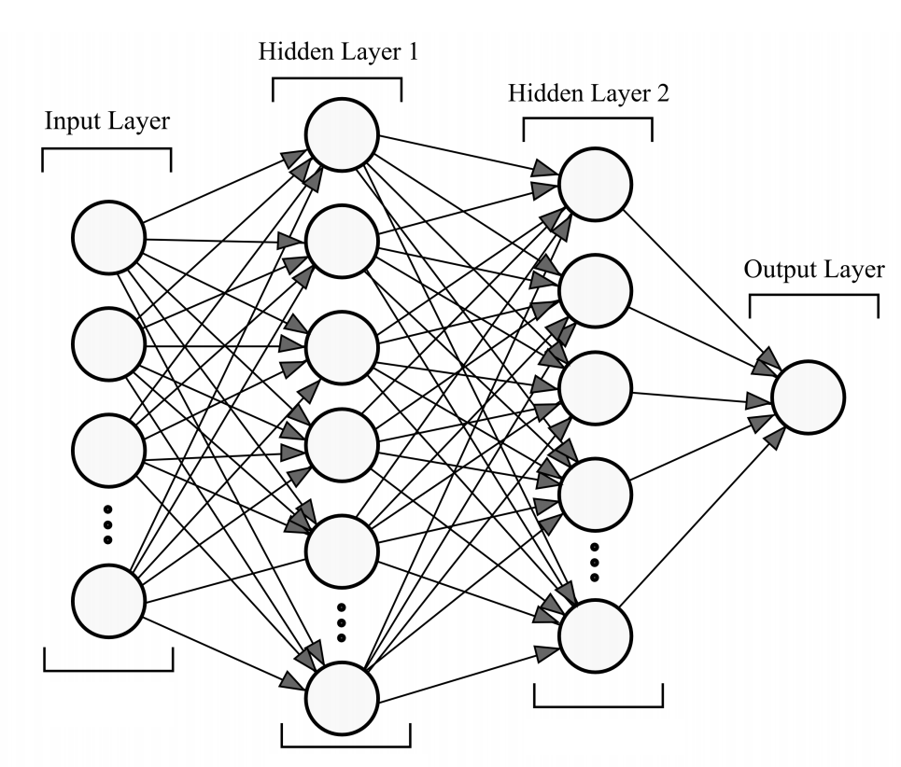
Multilayer Perceptron Network
W3
W10
W2
…
W1
…
T1
T2
T3
T10
Notes:
We experimented some models to estimate the total number of infected people in the weeks following the measurement. Neural networks did better among the researched algorithms.

Slide 33




Modelo Híbrido Sequencial
W1
W2
Today
…
…
W3
W1
W2
W3
W4
W5
…
…
…
Wn
Notes:
Then we propose a hybrid model to estimate the infected curve to be confirmed by the health system in the coming weeks in a given city.

Slide 34
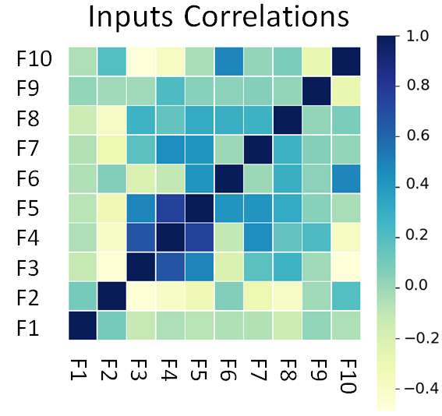
Data Preparation
F1: Infecteds SMA;
F2: Weekly cumulative raining precipitation (mm);
F3: Weekly cumulative evaporation (mm);
F4: Daily maximum temperature SMA (Celsius);
F5: Daily average temperature SMA (Celsius);
F6: Daily minimum temperature SMA (Celsius);
F7: Daily insolation SMA (hours);
F8: Daily wind speed SMA (m/s);
F9: City population;
F10: City population density.
Notes:
We gathered some measurements like:

Slide 35
Data Preparation
T5
Today
T4
T3
T10
T2
…
T1
T1: total confirmed cases in the 1st week ahead
Notes:
And the target was to hit the number of infected people who would go to the public health system and be really infected with dengue in the following week: the first week.

Slide 36
Data Preparation
T5
Today
T4
T3
T10
T2
…
T1
T2: total confirmed cases 2nd week ahead
Notes:
In the after ... Second week.

Slide 37
Data Preparation
T5
Today
T4
T3
T10
T2
…
T1
T3: total confirmed cases 3rd week ahead
Notes:
Third week...

Slide 38
Data Preparation
T5
Today
T4
T3
T10
T2
…
T1
T10: total confirmed cases 10th week ahead.
Notes:
So for as many weeks as we think possible. We made the decision to stop in the tenth week.

Slide 39
Data Preparation
T5
Today
T4
T3
T10
T2
…
T1
Notes:
After that...

Slide 40
Data Preparation
T5
Today
T4
T3
T10
T2
…
T1
Notes:
We do logistic regression to find a function that goes through all the estimated points. So it works like this:

Slide 41
Today
T1
T2
T3
T4
T5
…
T10
Confirmed
...to be confirmed
Notes:
The 10-week prediction ahead serves as a warning of an upward trend in the number of cases. Blue bars are confirmed cases and orange bars means estimation using the models... To be confirmed by the public system.

Slide 42
Today
T10
T1
T2
T3
T4
T5
…
Confirmed
...to be confirmed
Notes:
Ending a week, new data is generated and new prediction is made.

Slide 43
T10
Today
T5
T4
T1
T2
T3
…
Confirmed
...to be confirmed
Notes:
Ending a new week, and again, new prediction.

Slide 44
T10
T5
T4
Today
T3
T2
T1
…
Confirmed
...to be confirmed
Notes:
When the epidemic really starts, the system has already been alerting its onset a few weeks early.

Slide 45
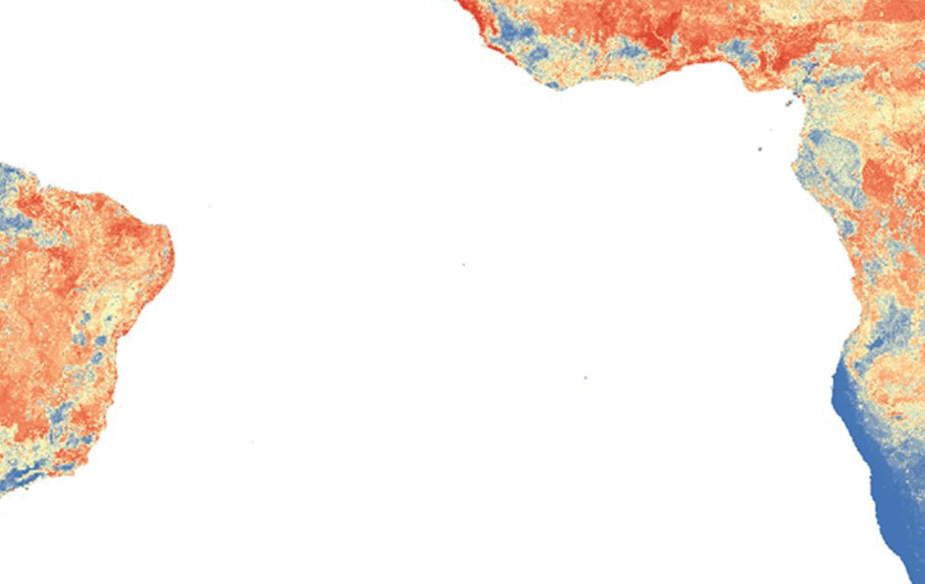
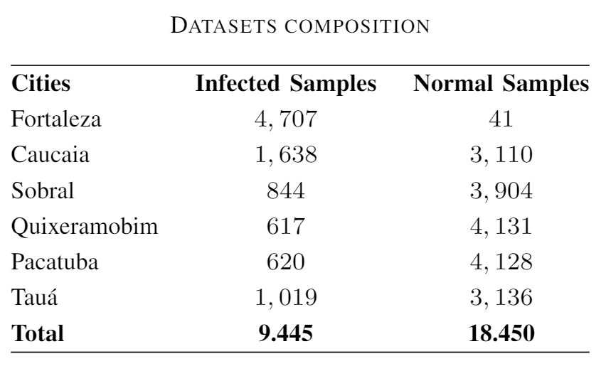

Samples
Notes:
Our study considered six cities with more varied populations. From small, medium, to large cities.

Slide 46
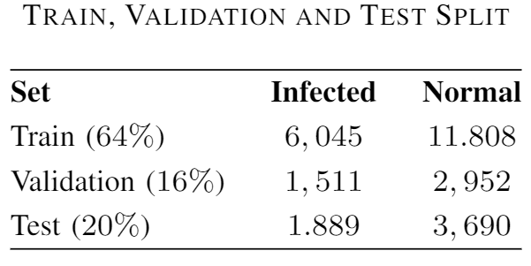
Dataset
Notes:
There were almost 28 thousand samples collected from 6 different cities, divided into training, validation and test sets.

Slide 47
Multilayer Perceptron Network
Activattion fucntion: ReLU
Estimator: Adaptative Momentum
T1
T2
T3
T4
T5
T6
T7
T8
T9
T10
Evaluate function: Maximum Absolute Error
Hidem layers: 2 fully connected
TX
10
neurons
206 neurons
206 neurons
Notes:
The architecture of each neural network is identical. With one input layer, 2 hiden layers and one output layer.

Slide 48
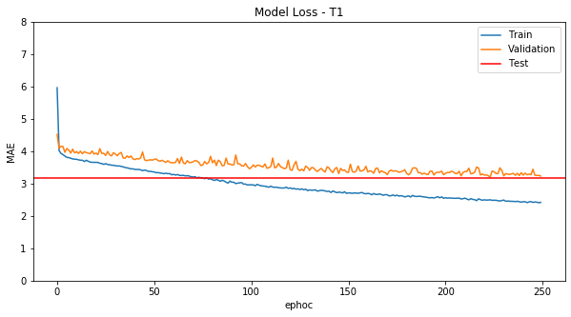
Model Evaluation
[Small cities – below 150k]
Notes:
Evaluating each model separately, it is clear that the more in the future the estimate is, the greater the mean absolute error observed. Here is the next week model.

Slide 49
Model Evaluation
[Small cities – below 150k]
Notes:
Blue line is results of train set error after each ephoc.
Orange line is validation set error and, red line is the error calculated once for test set in the end of 250 epochs of trainig. Besides test error is a dot, here’s a horizontal red line to give us better visualization.

Slide 50
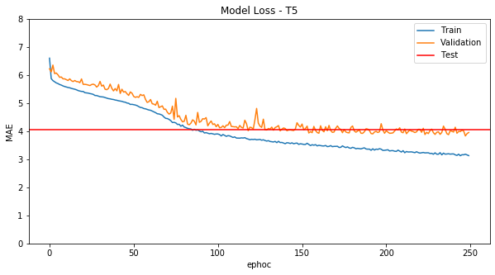
Model Evaluation
[Small cities – below 150k]
Notes:
Here the 5th week model.

Slide 51
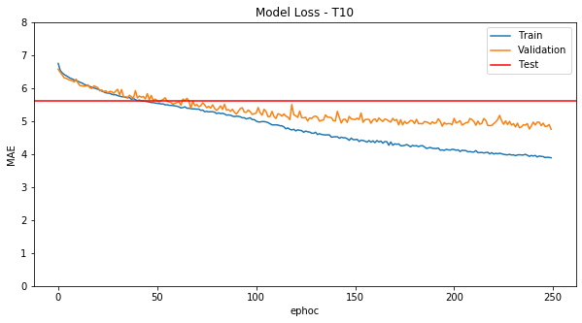
Model Evaluation
[Small cities – below 150k]
Notes:
And the 10th week model for smal cities.

Slide 52
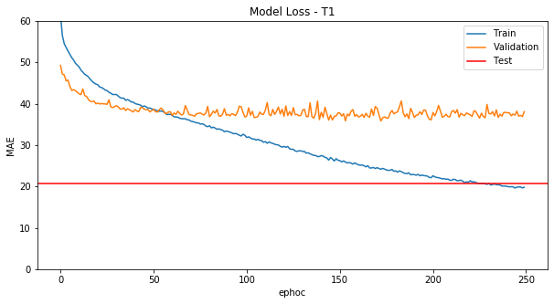
Model Evaluation
[Large cities – above 150k]
Notes:
Considering cities with more than 150 Thousand people, we got a greater error. Here the next week model.

Slide 53
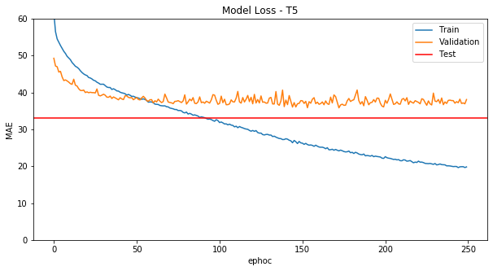
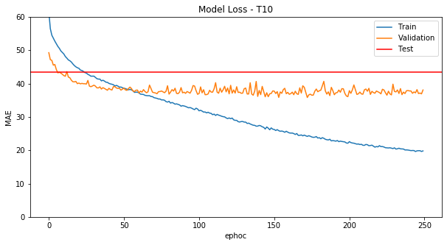
Model Evaluation
[Large cities – above 150k]
Notes:
We notice that the error is increasing in the same way as it does in small cities.

Slide 54
Presentation Sessions
Problem Defination
Proposed Solution
Results
Notes:
Results

Slide 55
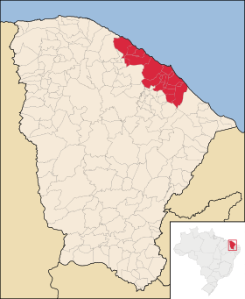
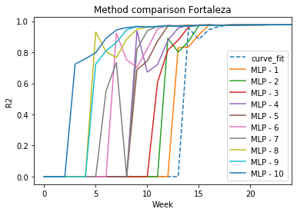
R² Method
Notes:
When we consider evaluating epidemics that occur in Fortaleza, the model shows that in the sixth week it is already possible to fully estimate a 30-week epidemic. R2 coefficient near to 1 means that the estimation meet the best accuracy for that epidemic. Using none of the models, just regression with the consolidated data, it would be made only nine weeks later.

Slide 56
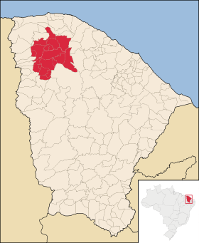
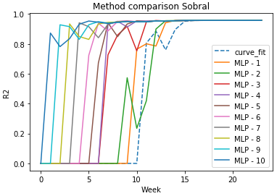
R² Method
Notes:
In Sobral, a city with almost 150,000 inhabitants, the model describes the entire epidemic as early as the fourth week.

Slide 57
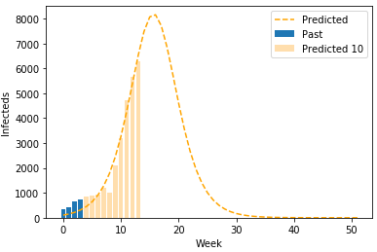
Dengue in Fortaleza, 2008
Source: SINAN, 2008
Notes:
Here’s a real epidemic that occured in 2008, in Fortaleza. In the fourth week, it is already possible to identify the week in which the peak occurs and when the epidemic is expected to end.

Slide 58
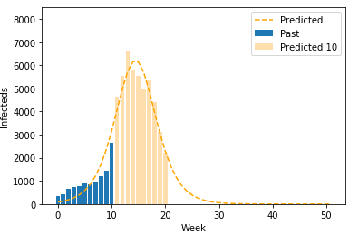
Dengue in Fortaleza, 2008
Source: SINAN, 2008
Notes:
In the tenth week, the model corrects the peak of infections that were overestimated.

Slide 59
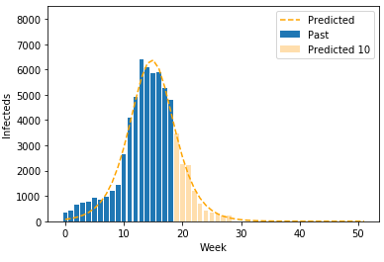
Dengue in Fortaleza, 2008
Source: SINAN, 2008
Notes:
After the peak, the estimation points to an end in that epidemic.

Slide 60
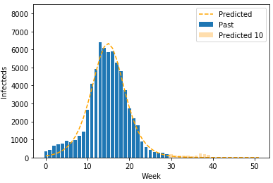
Dengue in Fortaleza, 2008
Source: SINAN, 2008

Slide 61
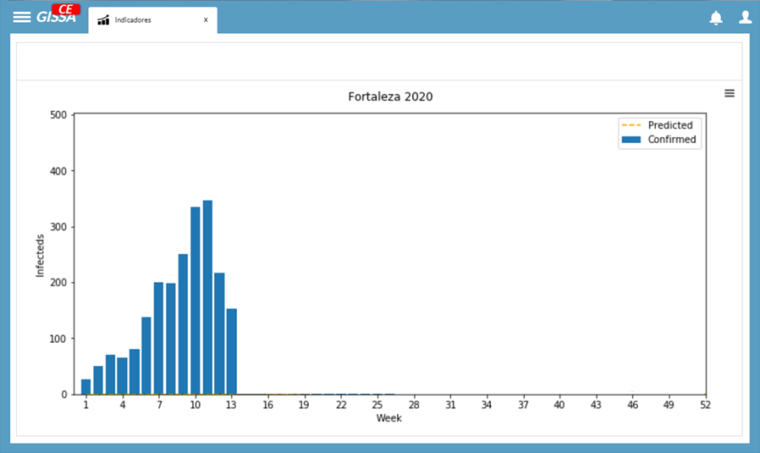

Correcting Instability
Source: SESA/COVEP/CEVEP/SINAN (Government of Ceará)
Notes:
For epidemic peaks that occurs relatively close, the system has a tendency to mask the reduction in the number of cases.

Slide 62
Correcting Instability
Source: SESA/COVEP/CEVEP/SINAN (Government of Ceará)
Notes:
As a solution, the second derivative is used to detect at what stage the epidemic is.

Slide 63

Correcting Instability
III
Source: SESA/COVEP/CEVEP/SINAN (Government of Ceará)
Notes:
Being in phase three (trend of reduction of infected), the system reduces the number of weeks estimated.

Slide 64
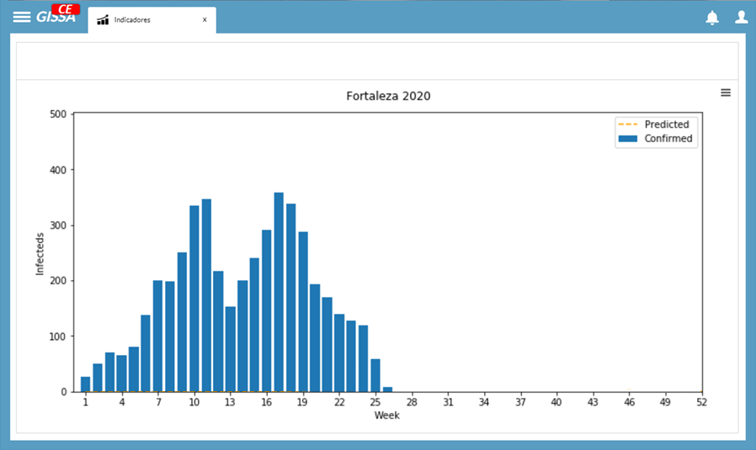

Correcting Instability
II
Source: SESA/COVEP/CEVEP/SINAN (Government of Ceará)
Notes:
Outside this stage, phases 1, 2 or 4, the system increases the number of weeks to 10 again.

Slide 65
Intelligent Epidemiological
Surveillance in the
Brazilian Semiarid
IEEE Healthcom 2020
Notes:
Here it is worth mentioning that each city showed a particular way in which epidemics occur. Future work can identify the feasibility of a model for each city. Since separate neural networks are used to predict each week ahead, chain neural networks could be tried to get better results on observed error.

Slide 66
Intelligent Epidemiological
Surveillance in the
Brazilian Semiarid
IEEE Healthcom 2020
Notes:
That’s all, thanks for join us and we are looking forward to answer any question.

